Slide 1
Time Series Analysis
Data
Page no 602, Business Statistics, Naval Bajpai, Pearson, 2nd edition

Slide 2
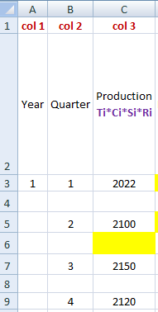
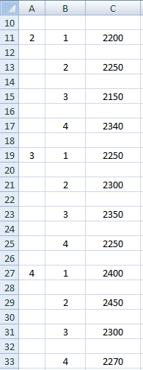
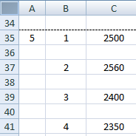
Data

Slide 3
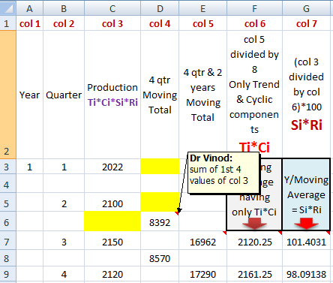
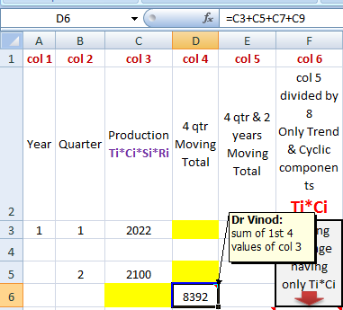
Column 4: Sum of 1st 4 values of column 3

Slide 4
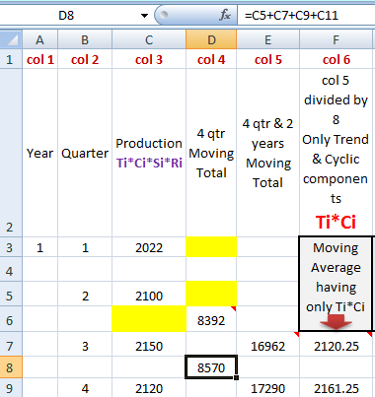
Column 4: Sum of 1st 4 values of column 3

Slide 5
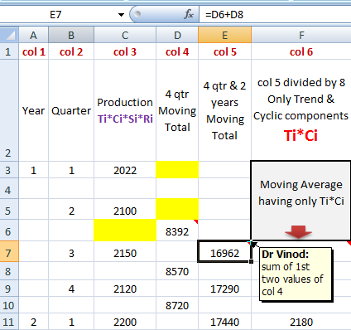
Column 5: 4 Quarter & 2 Years Moving Total (1st 2 of column 4)

Slide 6
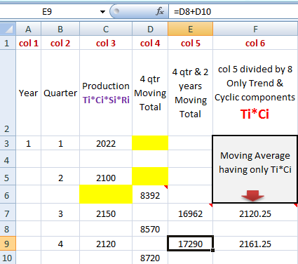
Column 5: 4 Quarter & 2 Years Moving Total (1st 2 of column 4)

Slide 7
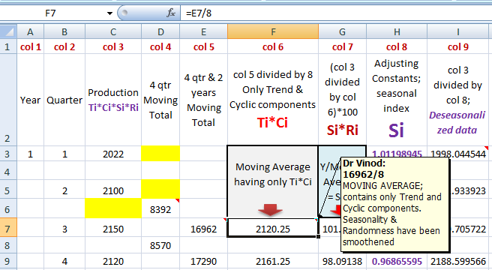
Column 6: (Column 5)/8

Slide 8
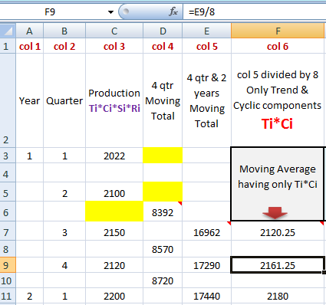
Column 6: (Column 5)/8

Slide 9
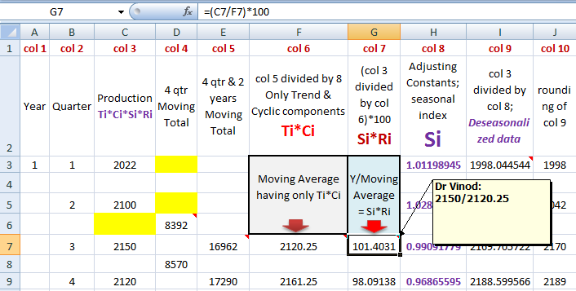
Column 7: [(column 3)/(column 6)]*100

Slide 10
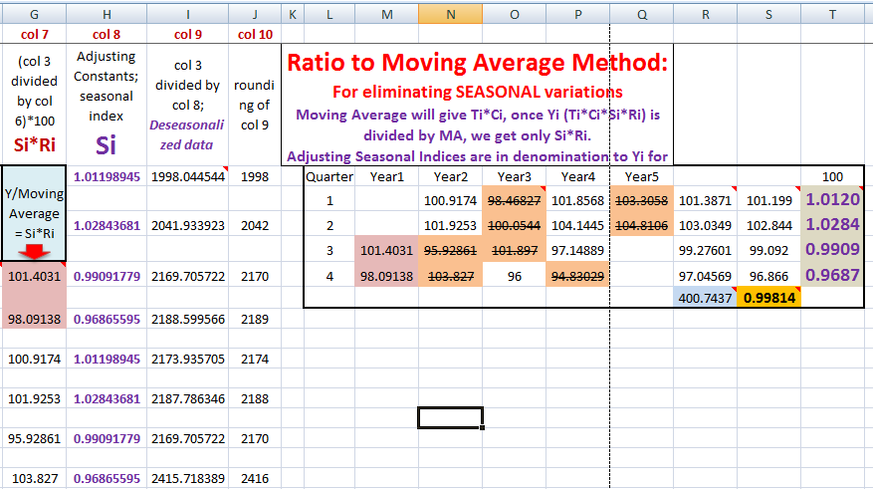
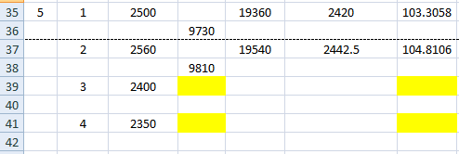
Create matrix from column 7

Slide 11
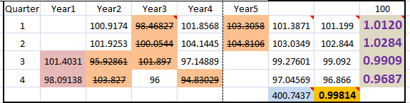
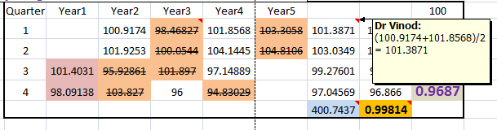
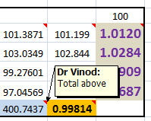
Strike off LOWEST and Highest, Quarter wise

Slide 12
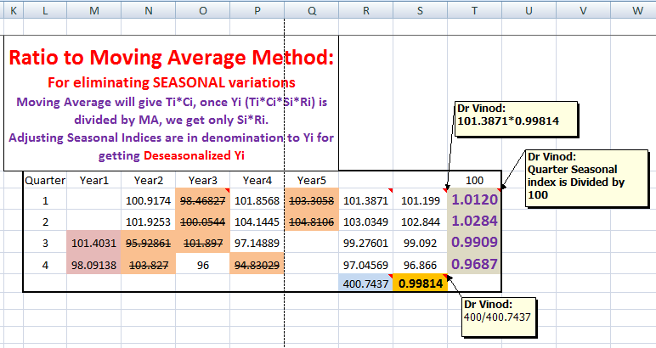
Three more calculations
2
3
1

Slide 13
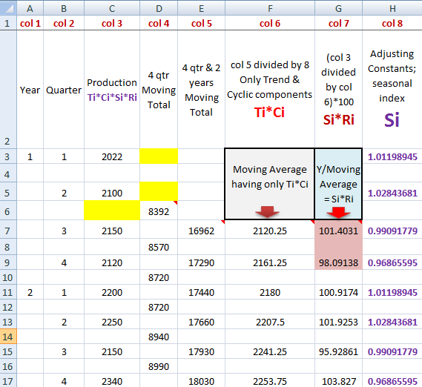
Column 8

Slide 14
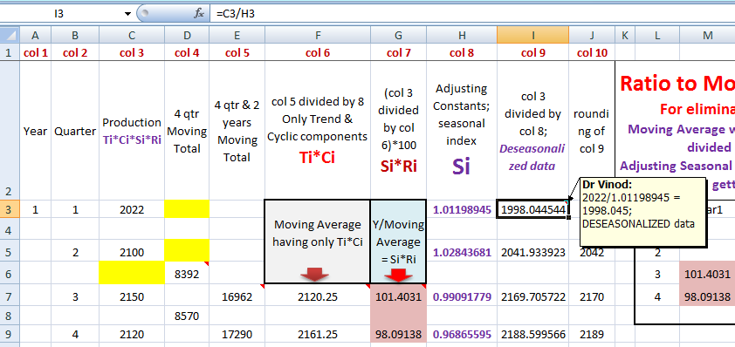
Column 9: De-seasonalized Data

Slide 15
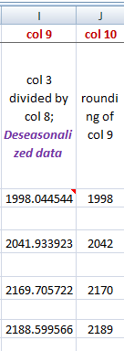
Column 10: Rounding off

Slide 16
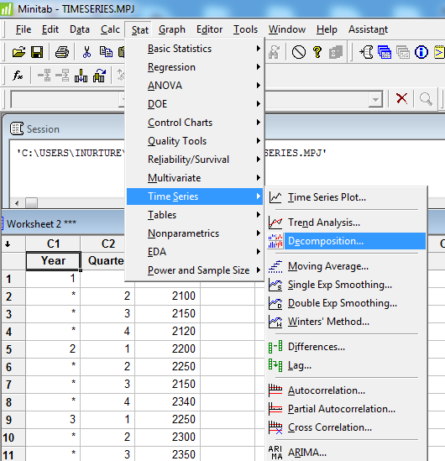
Stat → Time Series→ Decomposition

Slide 17
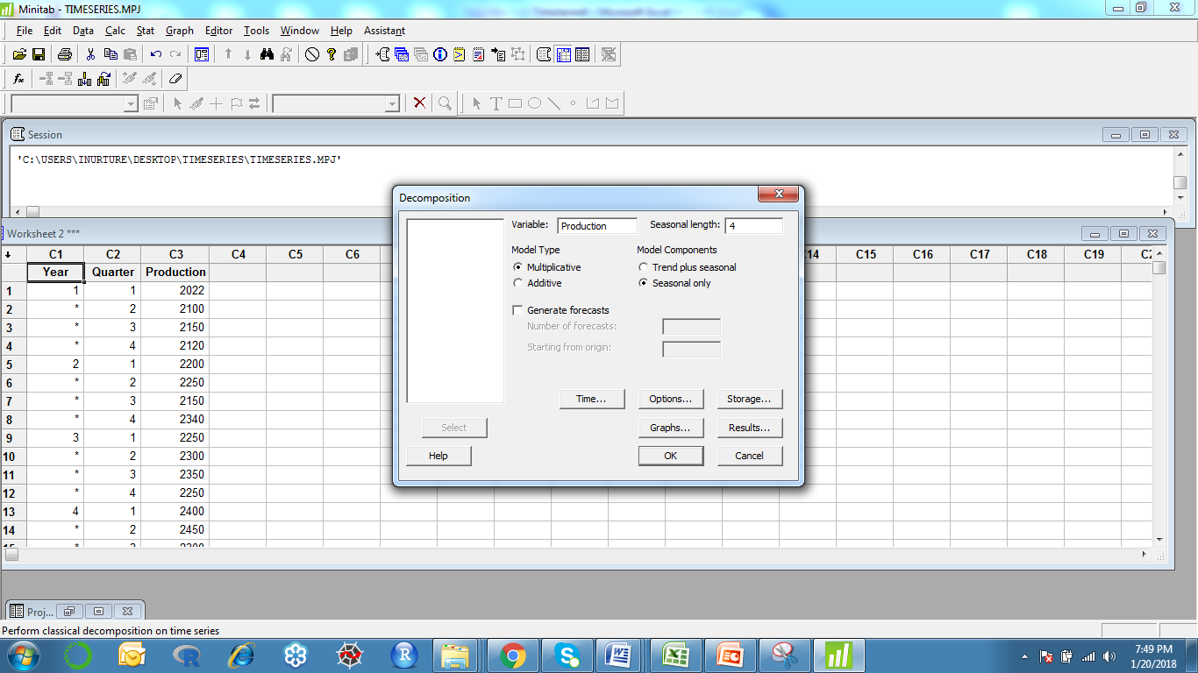
Place Production against Variable Seasonal length = 4 Model Type = Multiplicative; Model Components = Seasonal only → click Time…

Slide 18
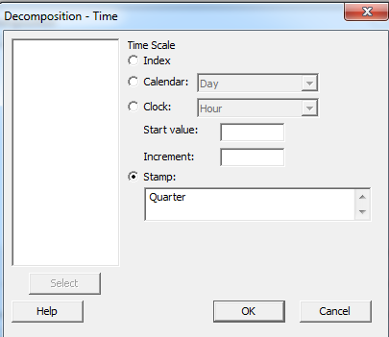
Bring Quarter under Stamp → OK

Slide 19
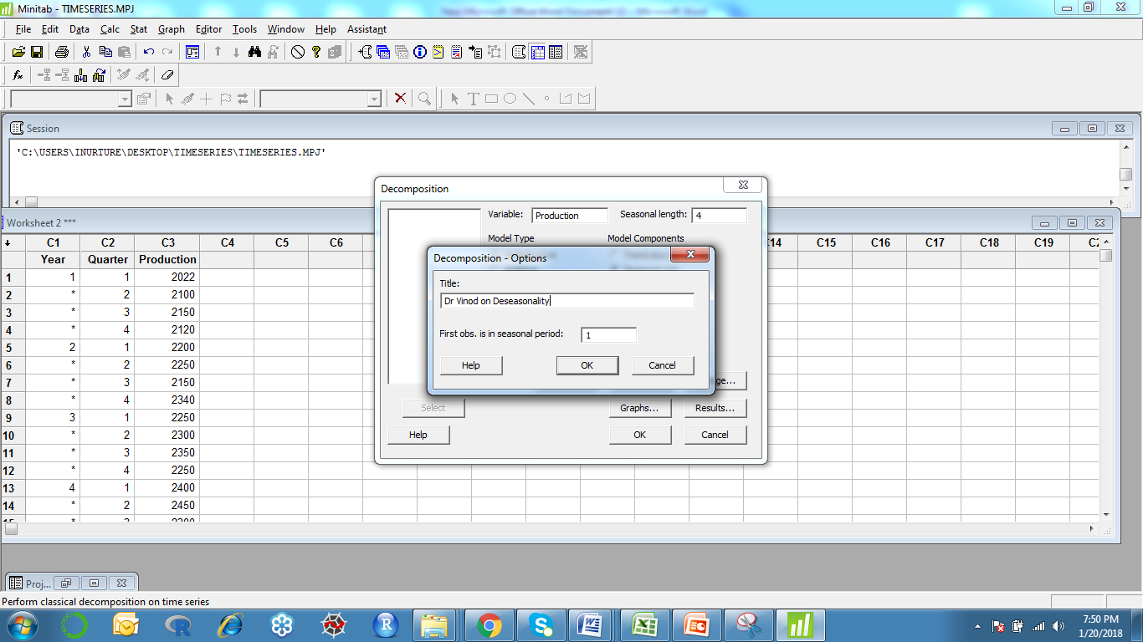
Click Options→ Give Title write 1 against First obs. is in seasonal period:→ click OK

Slide 20
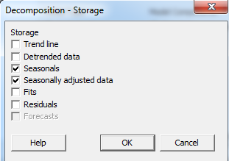
Click Storage→ check Seasonals & Seasonally adjusted data → OK

Slide 21
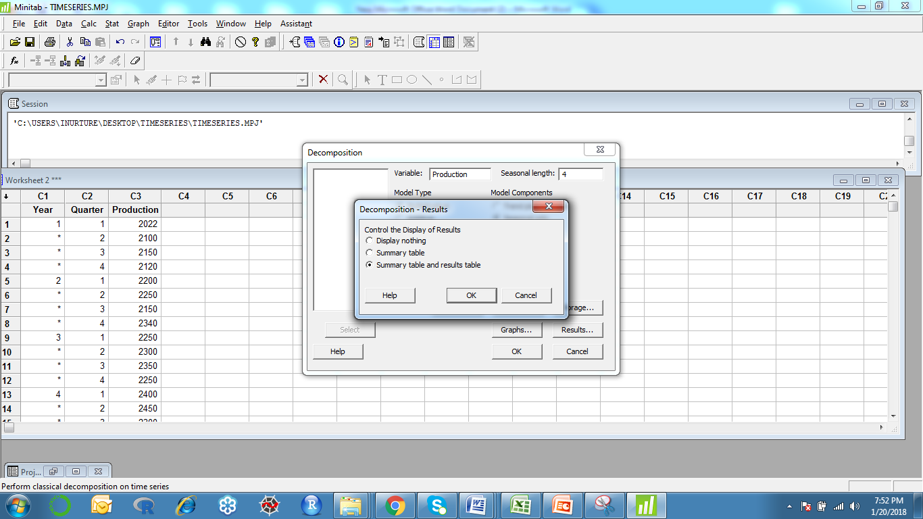
Go to Results…check Summary table and results table → OK

Slide 22
Graphs

Slide 23
Data

Slide 24
Data

Slide 25
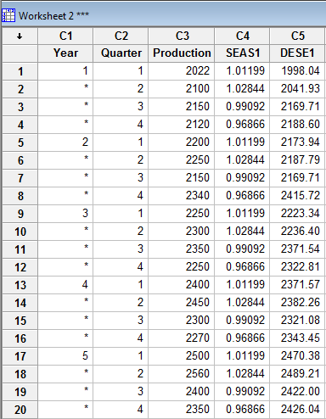
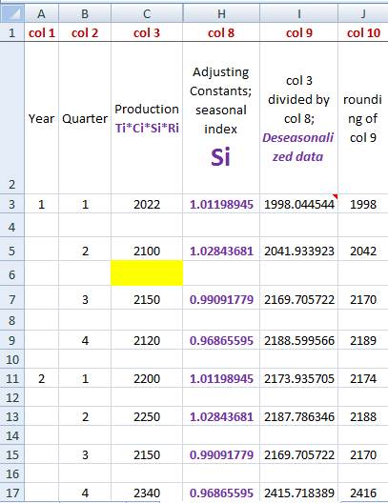

Slide 26
De-seasonality and De-trending
Find d from mid point
Find x = 2*d
Find xy, x^2, b = (SIGMA xy)/(SIGMA x^2), a = ybar
Find yhat, by b and a, Trend in MINITAB, Column L in excel (Predicted y, Trend values)
Find % of TREND = (y/ yhat) as Detrending in MINITAB; (y/ yhat)*100 as % of Trend,
Column M in excel
Find Predicted values after deseasonalization and detrending, yhat*seasonal index,
Predict in MINITAB, Column N in excel
Find Error, y minus Predicted values after deseasonalization and detrending (step 6)
Column O in excel

Slide 27
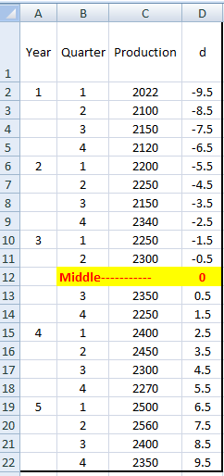
Step 1:
Find d

Slide 28
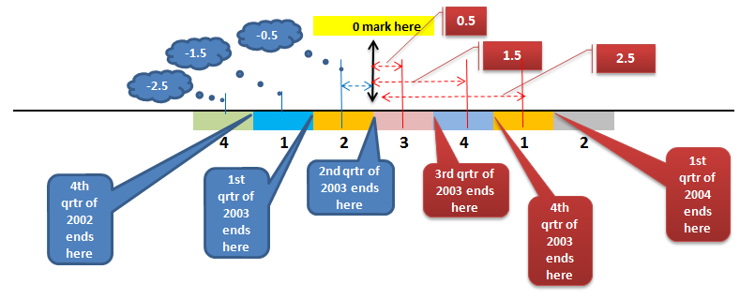
How d works out?

Slide 29
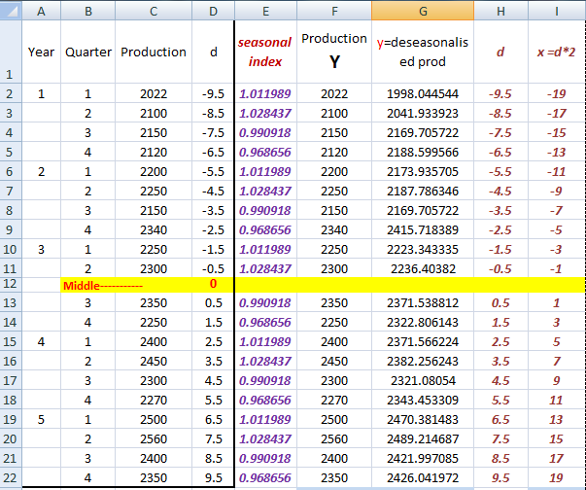
** column E and G
were calculated before
Step 2:
Find x=d*2

Slide 30
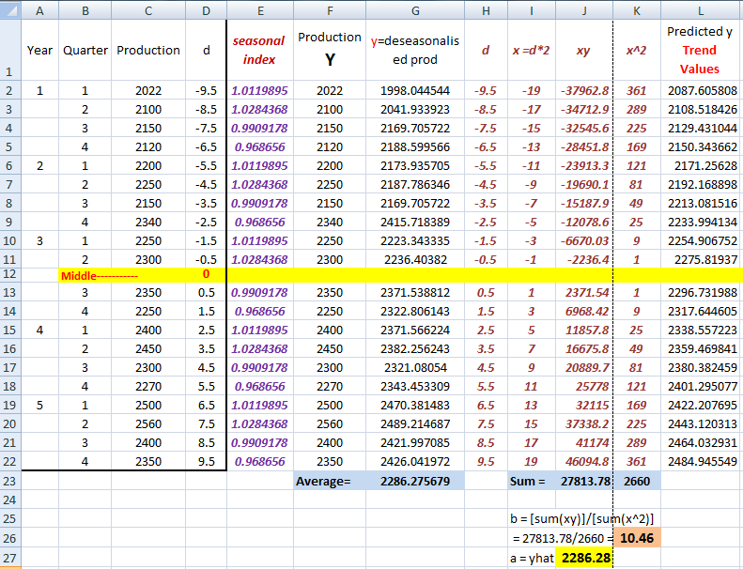


Slide 31
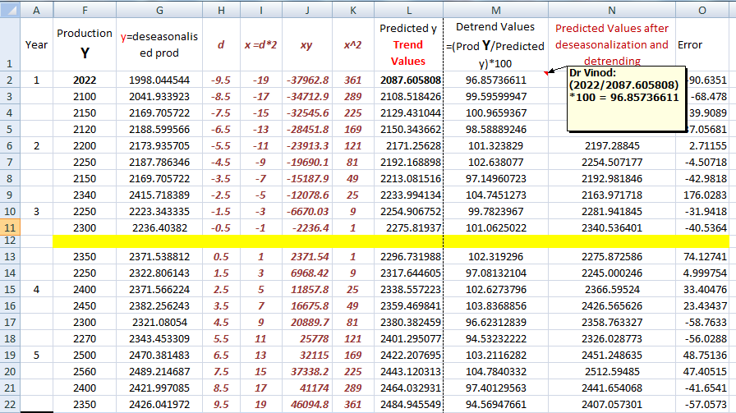

Slide 32
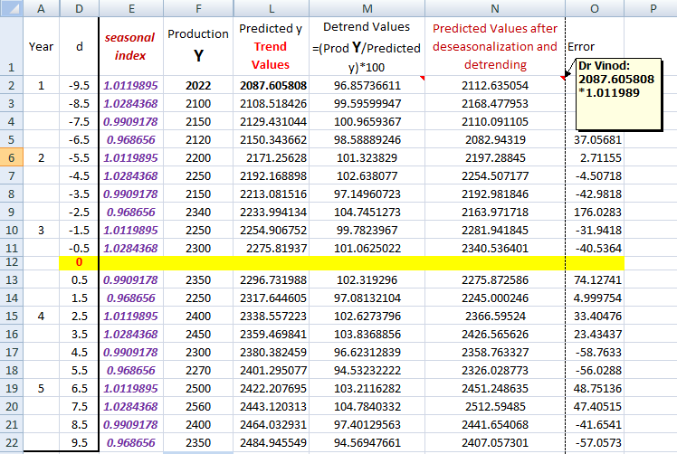

Slide 33
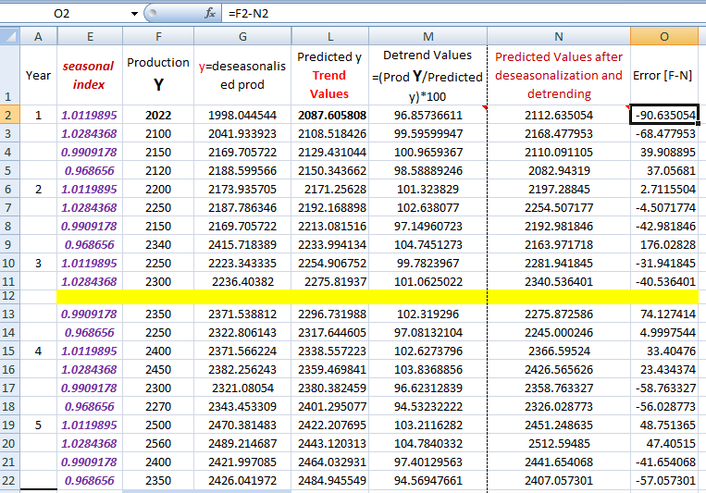

Slide 34
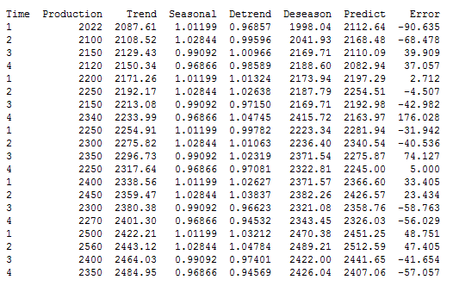
By regression, step 4, column L in excel, yhat
By Y/yhat, step 5, column M in excel
By yhat*seasonal index, step 6, column N in excel
By
y-(yhat*seasonal index), step 7, column O in excel
Original
y
These we had calculated before

Slide 35
Stat → Time Series→ Decomposition

Slide 36
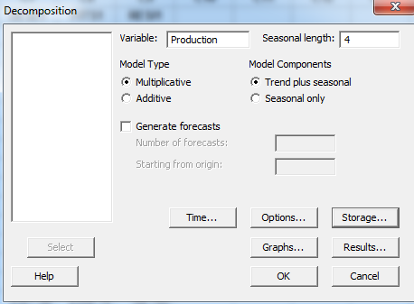
Place Production against Variable Seasonal length = 4 Model Type = Multiplicative; Model Components = Trend plus seasonal → click Time…

Slide 37
Bring Quarter under Stamp → OK

Slide 38
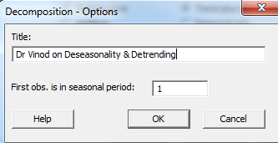
Click Options→ Give Title write 1 against First obs. is in seasonal period:→ click OK

Slide 39
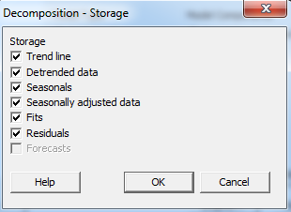
Click Storage→ check Seasonals & Seasonally adjusted data → OK

Slide 40
Go to Results…check Summary table and results table → OK

Slide 41
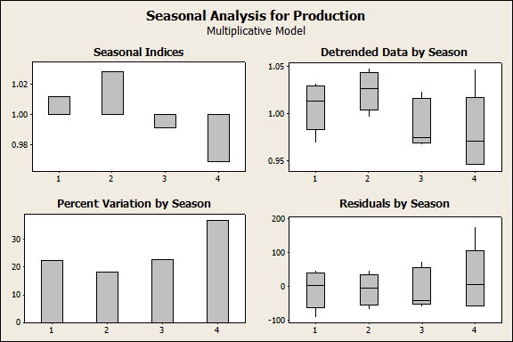
Graphs

Slide 42
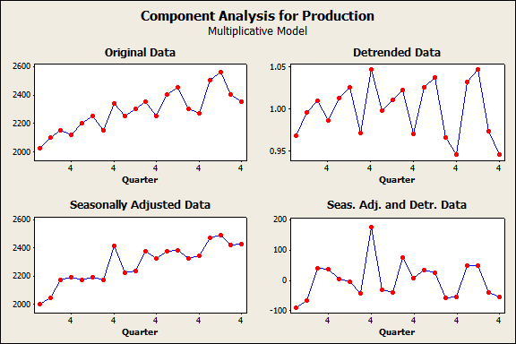
Graphs

Slide 43
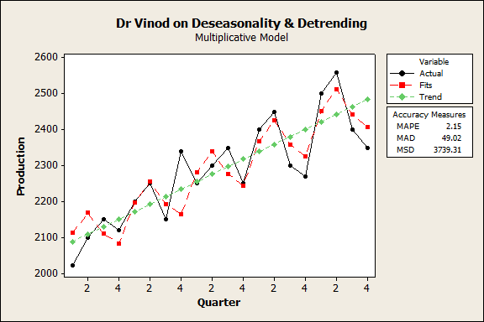
Graphs

Slide 44
MINITAB Output

Slide 45
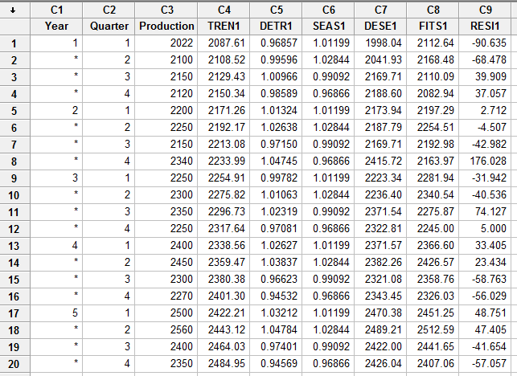
MINTAB Worksheet

Slide 46
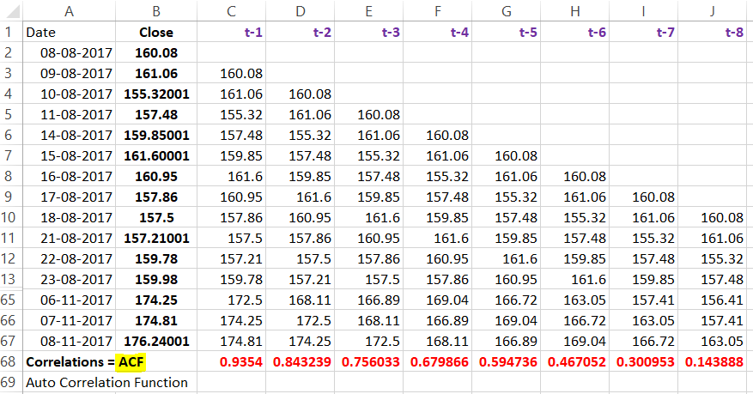
AR Concepts

Slide 47
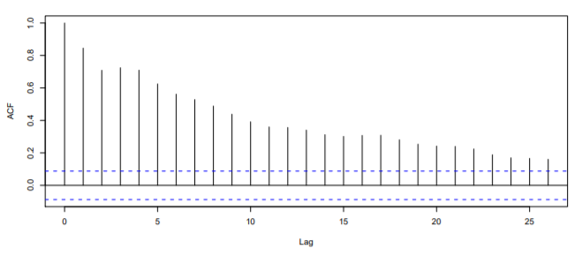
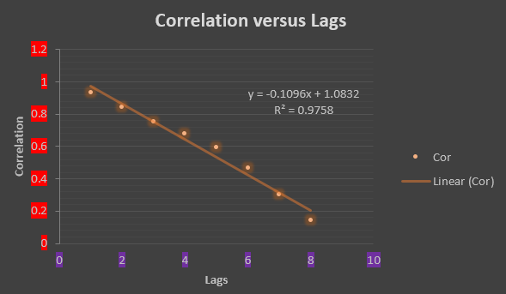
ACF

Slide 48
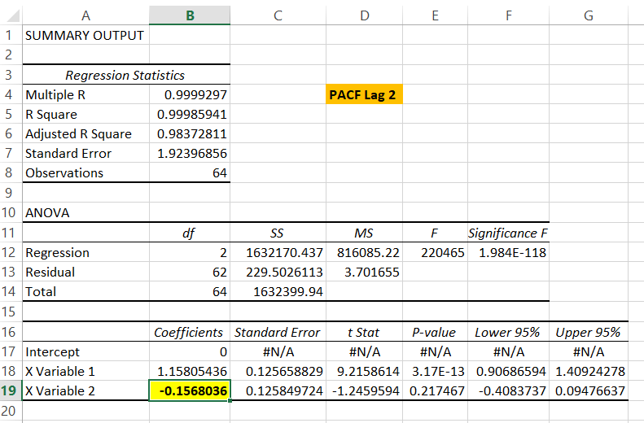
PACF
Intercept has to be kept as ZERO
PACF of Lag 2

Slide 49
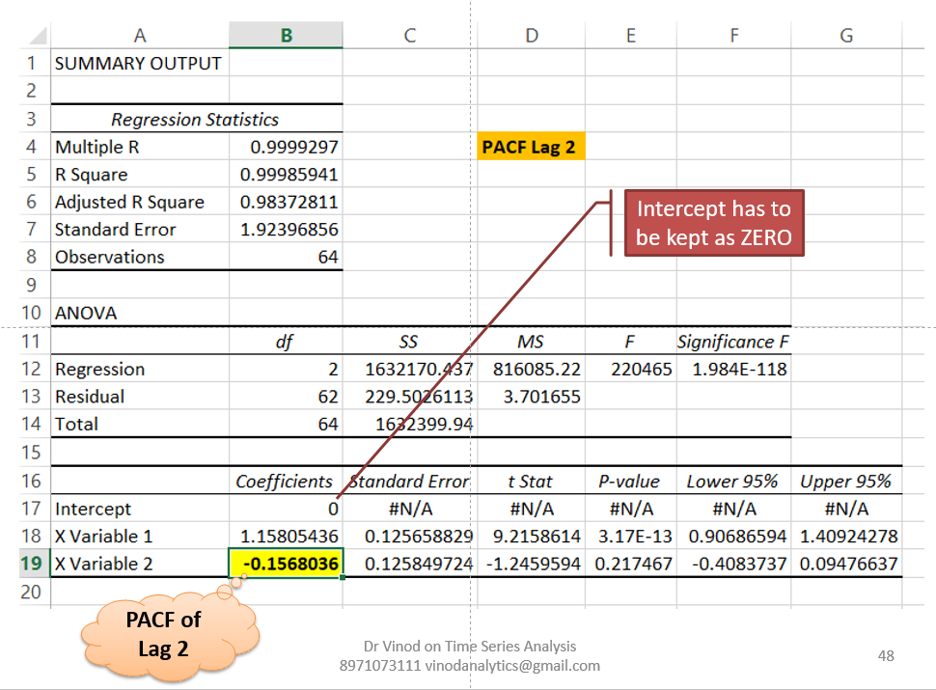
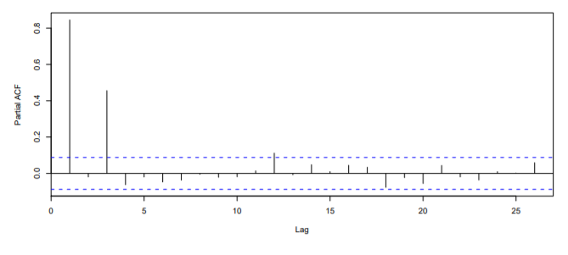
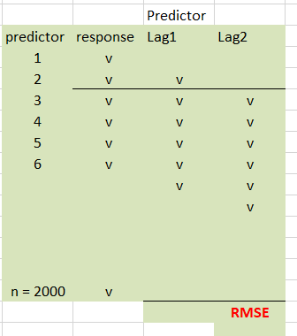
Sample PACF Diagram (Not of the same data)

Slide 50

ADF Test for stationarity
Ho: Data is not stationary
Ha: Data is stationary

Slide 51

Further Study Source: http://ucanalytics.com/blogs/step-by-step-graphic-guide-to-forecasting-through-arima-modeling-in-r-manufacturing-case-study-example

